Slide 1
Morphological Image Processing
Dr. Muhammad Zubair

Slide 2
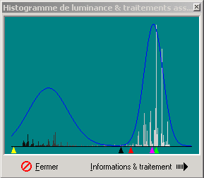
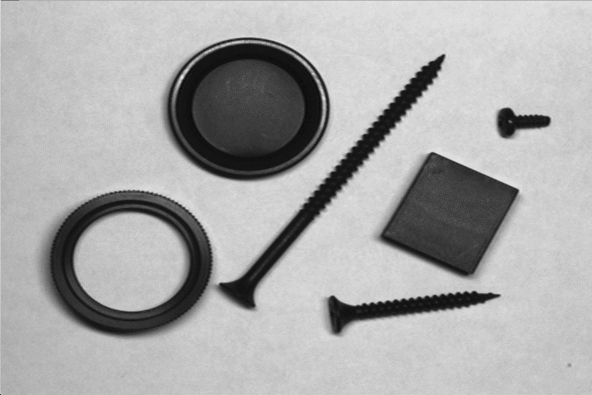
Gray Level Thresholding
Objects
Set threshold here
Introduction to Image Processing

Slide 3

Binary Image
Problem here
How do we fill “missing pixels”?

Slide 4
Contents
Once segmentation is complete, morphological operations can be used to remove imperfections in the segmented image and provide information on the form and structure of the image
In this lecture we will consider
What is morphology?
Simple morphological operations
Compound operations
Morphological algorithms

Slide 5
1, 0, Black, White?
Throughout all of the following slides whether 0 and 1 refer to white or black is a little interchangeable
All of the discussion that follows assumes segmentation has already taken place and that images are made up of 0s for background pixels and 1s for object pixels
After this it doesn’t matter if 0 is black, white, yellow, green…….

Slide 6
What Is Morphology?
Morphological image processing (or morphology) describes a range of image processing techniques that deal with the shape (or morphology) of features in an image
Morphological operations are typically applied to remove imperfections introduced during segmentation, and so typically operate on bi-level images

Slide 7
Quick Example
Image after segmentation
Image after segmentation and morphological processing

Slide 8
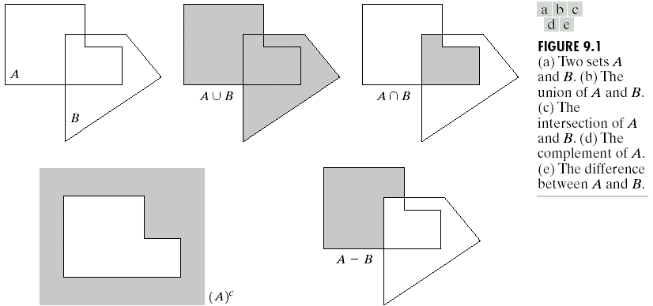
Basic Set Theory
8

Slide 9
Structuring Elements, Hits & Fits
B
Structuring Element
Fit: All on pixels in the structuring element cover on pixels in the image (A)
Hit: Any one pixel in the structuring element covers an one pixel in the image (B)
Miss: No pixel in the SE cover any pixel in the image (C)
A
C
All morphological processing operations are based on these simple ideas

Slide 10
Structuring Elements
Structuring elements can be any size and make any shape
However, for simplicity we will use rectangular structuring elements with their origin at the middle pixel
0 | 0 | 1 | 0 | 0
0 | 1 | 1 | 1 | 0
1 | 1 | 1 | 1 | 1
0 | 1 | 1 | 1 | 0
0 | 0 | 1 | 0 | 0
1 | 1 | 1
1 | 1 | 1
1 | 1 | 1
0 | 1 | 0
1 | 1 | 1
0 | 1 | 0

Slide 11
Examples: Structuring Elements
origin
11/21/2023
11

Slide 12
Fitting & Hitting
0 | 0 | 0 | 0 | 0 | 0 | 0 | 0 | 0 | 0 | 0 | 0
0 | 0 | 0 | 1 | 1 | 0 | 0 | 0 | 0 | 0 | 0 | 0
0 | 0 | 1 | 1 | 1 | 1 | 1 | 0 | 0 | 0 | 0 | 0
0 | 1 | 1 | 1 | 1 | 1 | 1 | 1 | 0 | 0 | 0 | 0
0 | 1 | 1 | 1 | 1 | 1 | 1 | 1 | 0 | 0 | 0 | 0
0 | 0 | 1 | 1 | 1 | 1 | 1 | 1 | 0 | 0 | 0 | 0
0 | 0 | 1 | 1 | 1 | 1 | 1 | 1 | 1 | 0 | 0 | 0
0 | 0 | 1 | 1 | 1 | 1 | 1 | 1 | 1 | 1 | 1 | 0
0 | 0 | 0 | 0 | 0 | 1 | 1 | 1 | 1 | 1 | 1 | 0
0 | 0 | 0 | 0 | 0 | 0 | 0 | 0 | 0 | 0 | 0 | 0
1 | 1 | 1
1 | 1 | 1
1 | 1 | 1
B
C
Structuring Element 1
0 | 1 | 0
1 | 1 | 1
0 | 1 | 0
A
Structuring Element 2

Slide 13
Fundamental Operations
Fundamentally morphological image processing is very like spatial filtering
The structuring element is moved across every pixel in the original image to give a pixel in a new processed image
The value of this new pixel depends on the operation performed
There are two basic morphological operations: erosion and dilation

Slide 14

Erosion
Erosion of image f by structuring element s is given by f Θ s
The structuring element s is positioned with its origin at (x, y) and the new pixel value is determined using the rule:
$$g\left(x,y\right)=\left\{\begin{matrix}\text{1 }\text{if} s \text{fits} f \\ \text{0 }\text{otherwise}\end{matrix}\right.$$

Slide 15
Erosion Example
Original Image
Processed Image With Eroded Pixels
Structuring Element

Slide 16
Erosion Example
Original Image
Processed Image
Structuring Element

Slide 17
Erosion Example
17

Slide 18

Erosion Example 1
Original image
Erosion by 3*3 square structuring element
Erosion by 5*5 square structuring element
Watch out: In these examples a 1 refers to a black pixel!

Slide 19
Erosion Example 1
Original image
After erosion with a disc of radius 10
After erosion with a disc of radius 5
After erosion with a disc of radius 20

Slide 20
What Is Erosion For?
Erosion can split apart joined objects
Erosion can strip away extrusions
Watch out: Erosion shrinks objects
Erosion can split apart

Slide 21


Dilation
Dilation of image f by structuring element s is given by f s
The structuring element s is positioned with its origin at (x, y) and the new pixel value is determined using the rule:
$$⊕$$
$$g\left(x,y\right)=\left\{\begin{matrix}\text{1 }\text{if} s \text{hits} f \\ \text{0 }\text{otherwise}\end{matrix}\right.$$

Slide 22
Dilation Example
Original Image
Processed Image
Structuring Element

Slide 23
Dilation Example
Original Image
Processed Image With Dilated Pixels
Structuring Element

Slide 24
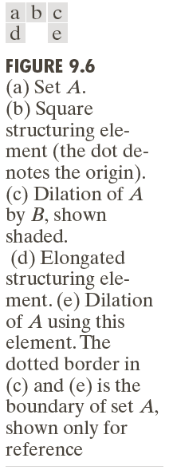
Dilation Example

Slide 25

Dilation Example 1
Original image
Dilation by 3*3 square structuring element
Dilation by 5*5 square structuring element
Watch out: In these examples a 1 refers to a black pixel!

Slide 26
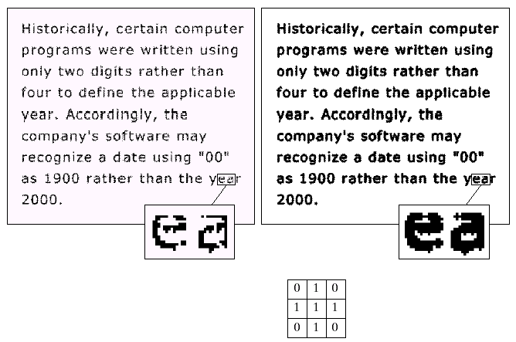
Dilation Example 2
Original image
After dilation
Structuring element

Slide 27
What Is Dilation For?
Dilation can repair breaks
Dilation can repair intrusions
Watch out: Dilation enlarges objects

Slide 28
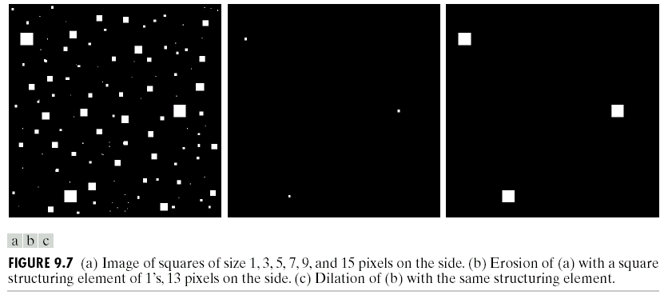
Combining The Operations

Slide 29
Compound Operations
More interesting morphological operations can be performed by performing combinations of erosions and dilations
The most widely used of these compound operations are:
Opening
Closing

Slide 30
Opening and Closing
Opening generally smoothes the contour of an object, breaks narrow isthmuses, and eliminates thin protrusions
Closing tends to smooth sections of contours but it generates fuses narrow breaks and long thin gulfs, eliminates small holes, and fills gaps in the contour

Slide 31
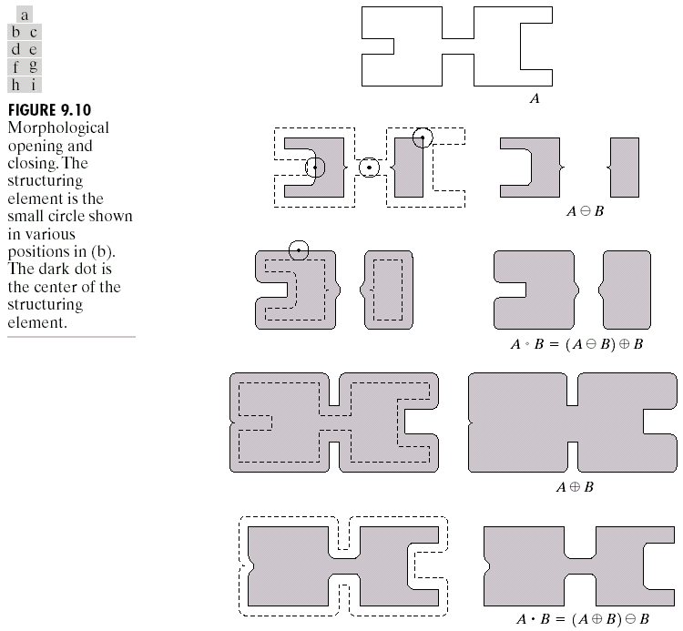

Opening
The opening of image f by structuring element s, denoted f ○ s is simply an erosion followed by a dilation
f ○ s = (f Θ s) s
$$⊕$$
Original shape
After erosion
After dilation (opening)
Note a disc shaped structuring element is used

Slide 32
Opening Example
Original Image
Image After Opening

Slide 33
Opening Example
Original Image
Processed Image
Structuring Element

Slide 34
Opening Example
Original Image
Processed Image
Structuring Element

Slide 35

Closing
The closing of image f by structuring element s, denoted f • s is simply a dilation followed by an erosion
f • s = (f s) Θ s
$$⊕$$
Original shape
After dilation
After erosion (closing)
Note a disc shaped structuring element is used

Slide 36
Closing Example
Original Image
Image After Closing

Slide 37
Closing Example
Original Image
Processed Image
Structuring Element

Slide 38
Closing Example
Original Image
Processed Image
Structuring Element

Slide 39
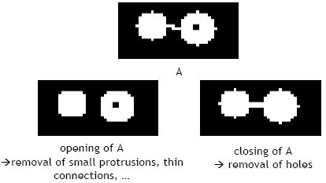
Opening & Closing

Slide 40
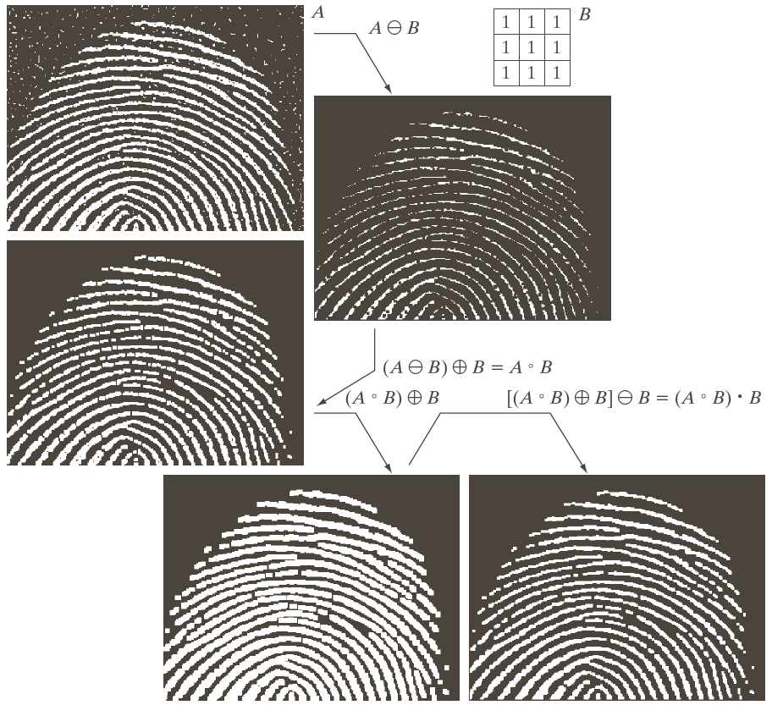


Slide 41
Opening vs Closing
Opening
A ○ B is sub set of the original image A
If C is subset of D then C ○ B is a subset of D ○ B
(A ○ B) o B = A ○ B
Closing
A is subset of A • B
If C is subset of D then C • B is subset of D • B
(A • B) • B = A • B
Note: repeated openings/closings has no effect!

Slide 42
Morphological Algorithms
Using the simple technique we have looked at so far we can begin to consider some more interesting morphological algorithms
We will look at:
Hit Miss Transform
Boundary extraction
Region filling
There are lots of others as well though:
Extraction of connected components
Thinning/thickening
Skeletonisation

Slide 43

Hit Miss Transform
Find location of one shape among a set of shapes ”template matching
Composite SE: object part (B1) and background part (B2)
Does B1 fits the object while, simultaneously, B2 misses the object, i.e., fits the background?
(A Θ B1) ∩ (A^{C} Θ B2) where B2 = (W - B)
Represented with ⊛

Slide 44
Hit Miss Transform
44

Slide 45
Boundary Extraction
Extracting the boundary (or outline) of an object is often extremely useful
The boundary of a set A, can be obtained by first eroding A by B and then performing the set difference between A and its erosion.
The boundary can be given simply as
β(A) = A – (AΘB)
11/21/2023
45

Slide 46
Boundary Extraction
11/21/2023
46

Slide 47
Boundary Extraction Example
11/21/2023
47

Slide 48


Boundary Extraction Example
Original Image
Extracted Image

Slide 49
Region Filling
A hole may be defined as a background region surrounded by a connected border of foreground pixels.
Let A denote a set whose elements are 8-connected boundaries, each boundary enclosing a background region (i.e., a hole). Given a point in each hole, the objective is to fill all the holes with 1s.
11/21/2023
49

Slide 50
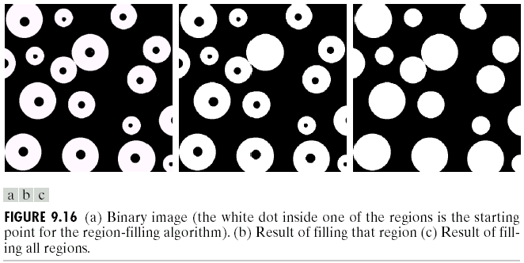
Region Filling
Given a pixel inside a boundary, region filling attempts to fill that boundary with object pixels (1s)
Given a point inside here, can we fill the whole circle?

Slide 51

Region Filling
Key equation for region filling is
X₀ is the starting point inside the boundary,
B is a structuring element
A^{c} is the complement of A
Continue until X_{k} = X_{k-1}
Final Step: Union the result & the original boundary
$$X_{k}=\left(X_{k−1}⊕B\right)∩A^{c} k=1,2,3\text{.....}$$

Slide 52
Example
11/21/2023
52

Slide 53
Region Filling Example
Original Image
One Region Filled
All Regions Filled

Slide 54
Summary
The purpose of morphological processing is primarily to remove imperfections added during segmentation
The basic operations are erosion and dilation
Using the basic operations we can perform opening and closing
More advanced morphological operation can then be implemented using combinations of all of these

